Slide 1
Slider Control using Ramping library
Team Members
Aditya Jain
Amal George M

Slide 2
Objective :-
To form a customized ramping library compatible with L293D and Sabertooth to precisely control the position of Slider

Slide 3
Approach
Since the velocity of motor can be controlled using PWM, so the using analogWrite() for L293D and L298 control and USBSabertooth library is used to control Sabertooth 2x32.
The PWM corresponding to the desired velocity is given to the motor driver at the desired time till it changes from initial to final rpm.

Slide 4
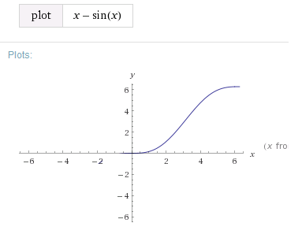
Ramping function
The transition of velocity has to be smooth when velocity changes from any value V1 to V2. A curve like x-sin x has this properties. So in order to implement S-ramping this function is used with lower limit 0 till upper limit 2pi.

Slide 5
Here the major challenge was to simultaneously run ramping along with different other operations.
Possible Methods :
Implementing ramping in the loop.
Implement ramping as an Timed interrupt Function.

Slide 6
Ramping as Interrupt
Merit:
Ramping will occur at specified intervals, without any influence.
Demerit:
Interrupts other functions and interrupts during execution of ramping function.

Slide 7
Ramping inside Loop
Merit:
No influence on other functions or interrupts running on Arduino.
Demerit:
Number of ramping calls (Smoothness) will depend upon the time taken to execute the loop.

Slide 8
About Library
Features :
Option to chose any Function for ramping
Can manually control the time of ramping
Compatible with variety of Drivers.
Auto correction for varying analog inputs
Structure :
Implemented using class, using function overloading for compatibility
Rmp() : This function finds the required pwm and sets the motor to that pwm once ramping has started. Implemented in loop().
Setspeed() : Function takes PWM to which motor has to be ramped and starts the ramping. Implemented in loop where change in speed is required

Slide 9
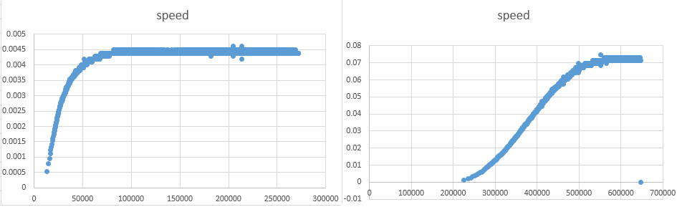
Results:
Comparison of Unramped (right) and Ramped (left) control of velocity against time. The function used for ramping is x-sin(x).

Slide 10
Slider Control using feedback
Aim:
To move the Slider to a desired position within least possible time without jerks in the motion.

Slide 11
Approach 1
Incremental encoder provides angular displacement as feedback, using PID control(Proportional Integrational Differential) on this value the desired pwm is found for the driving motor at each instant till it reaches the final destination and stops.
Features:
Accurate within 0.1 mm .
Easy to calibrate for different velocities.
PID automatically adjusts slider even if varying external force is acting on slider.

Slide 12
Approach 2
Ramping is done to move the slider from initial to final position. Implemented as Goto.h
Features:
No Oscillation.
System dependent calibration.

